Slide 1

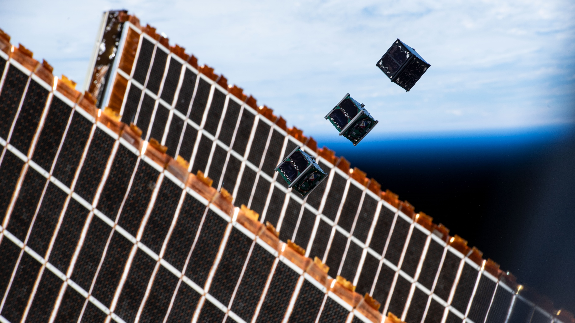



SCHOOL HOLIDAY
PROGRAM SUMMER 2024

Slide 2
Why is Simulation
“But Kyle, I don’t need to simulate it. I can just launch it and measure the results!”
- Some lame person
Original Slide Design: Lorian Marshall
Notes:
Fergus talk about this one?

Slide 3
Why is Simulation
Benefits of Practical Testing
Original Slide Design: Lorian Marshall
Notes:
Fergus talk about this one?

Slide 4
Why is Simulation
Benefits of Practical Testing
Can be easier
– You don’t need to know how it works
Direct
– You observe the actual event
Certainty
- No doubt about the validity of the system
It’s fun to launch rockets
Original Slide Design: Lorian Marshall
Notes:
Fergus talk about this one?

Slide 5
Why is Simulation
Benefits of Practical Testing
Can be easier
– You don’t need to know how it works
Direct
– You observe the actual event
Certainty
- No doubt about the validity of the system
It’s fun to launch rockets
Benefits of Modelling and Simulation
Original Slide Design: Lorian Marshall
Notes:
Fergus talk about this one?

Slide 6
Why is Simulation
Benefits of Practical Testing
Can be easier
– You don’t need to know how it works
Direct
– You observe the actual event
Certainty
- No doubt about the validity of the system
It’s fun to launch rockets
Benefits of Modelling and Simulation
You can do it cheaper (sometimes)
- No material costs
Faster and more often
- Don’t have to wait to build/approve/fix
Safer
- If it goes wrong, you know beforehand
More controllable
- Can set up the situations you want
- Can get the data you want
Original Slide Design: Lorian Marshall
Notes:
Fergus talk about this one?

Slide 7
How is Simulation
Three things are needed for a simulation
Original Slide Design: Lorian Marshall
Notes:
Fergus talk about this one?

Slide 8
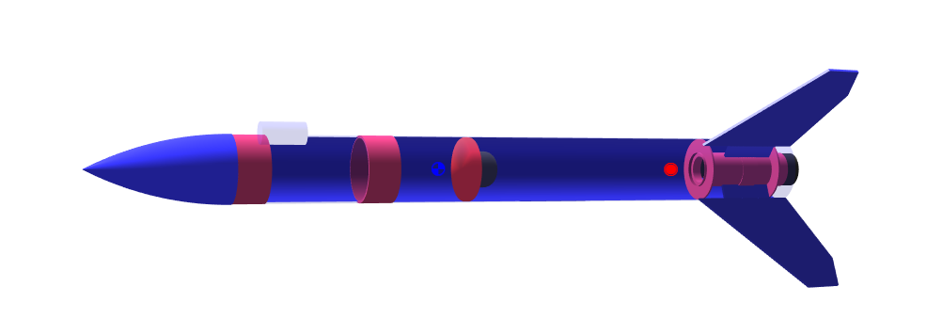
How is Simulation
Three things are needed for a simulation
A model of the test item
Original Slide Design: Lorian Marshall
Notes:
Fergus talk about this one?

Slide 9
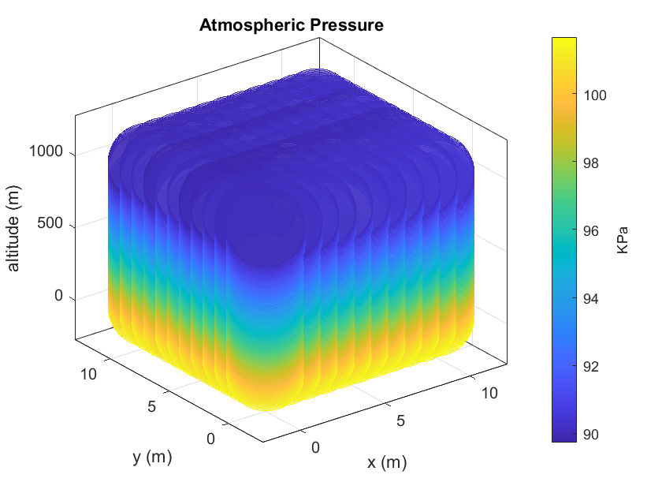
How is Simulation
Three things are needed for a simulation
A model of the test item
A model of the environment
Original Slide Design: Lorian Marshall
Notes:
Fergus talk about this one?

Slide 10
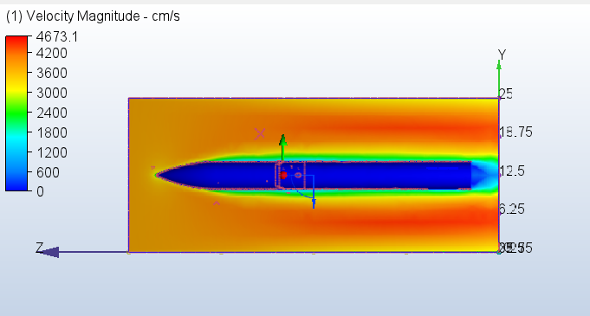
How is Simulation
Three things are needed for a simulation
A model of the test item
A model of the environment
Rules for how they interact
Original Slide Design: Lorian Marshall
Notes:
Fergus talk about this one?

Slide 11
Who is Simulation
OpenRocket
Rocksim
RocketModeler
Silicium Model Rocket Simulator
Probably many more
Original Slide Design: Lorian Marshall
Notes:
Fergus talk about this one?

Slide 12
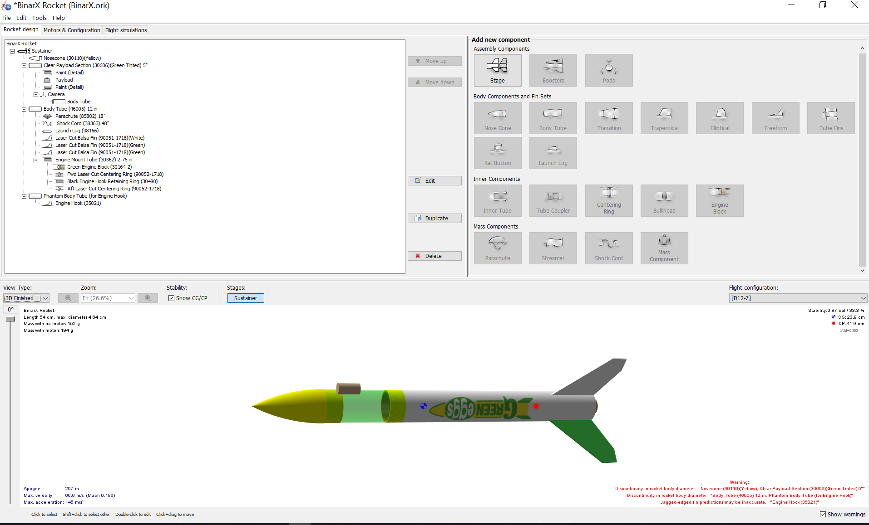
Who is Simulation
OpenRocket ←
Rocksim
RocketModeler
Silicium Model Rocket Simulator
Probably many more
Original Slide Design: Lorian Marshall
Notes:
Fergus talk about this one?

Slide 13
Why Use Someone Else’s Simulator?
Well… It’s kinda complicated
Original Slide Design: Lorian Marshall
Notes:
Fergus talk about this one?

Slide 14

Why Use Someone Else’s Simulator?
Well… It’s kinda complicated
Simplified Equation
$$\frac{ds^{2}}{dt^{2}}=\left\{\begin{matrix}\frac{\frac{F_{r}\left(t_{r}−t\right)}{t_{r}}−\frac{1}{2}ρ{\left(\frac{ds}{dt}\right)}^{2}AC_{D}\hat{v}−g}{m_{r}+\frac{m_{f}\left(t_{r}−t\right)}{t_{r}}} & t≤t_{r} \\ \frac{−\frac{1}{2}ρ{\left(\frac{ds}{dt}\right)}^{2}AC_{D}\hat{v}−g}{m_{r}} & t>t_{r}\end{matrix}\right\}$$
Original Slide Design: Lorian Marshall
Notes:
Fergus talk about this one?

Slide 15
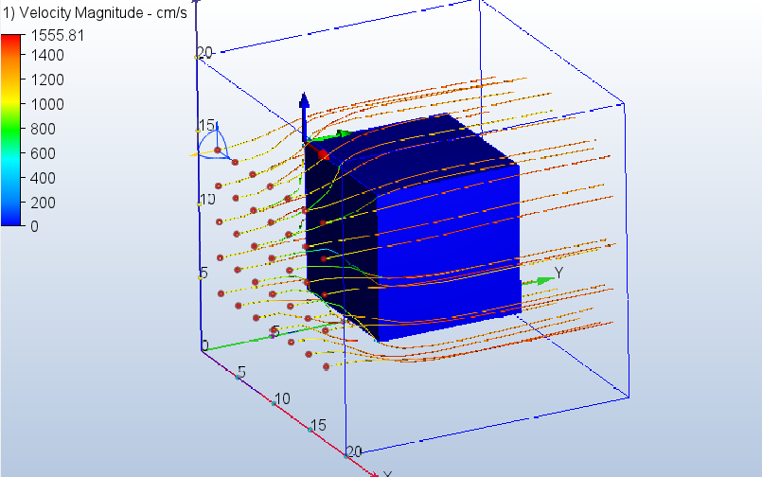
Why Use Someone Else’s Simulator?
Well… It’s kinda complicated
Computational fluid dynamics (CFD)
Simplified Equation
$$\frac{ds^{2}}{dt^{2}}=\left\{\begin{matrix}\frac{\frac{F_{r}\left(t_{r}−t\right)}{t_{r}}−\frac{1}{2}ρ{\left(\frac{ds}{dt}\right)}^{2}AC_{D}\hat{v}−g}{m_{r}+\frac{m_{f}\left(t_{r}−t\right)}{t_{r}}} & t≤t_{r} \\ \frac{−\frac{1}{2}ρ{\left(\frac{ds}{dt}\right)}^{2}AC_{D}\hat{v}−g}{m_{r}} & t>t_{r}\end{matrix}\right\}$$
Original Slide Design: Lorian Marshall
Notes:
Fergus talk about this one?

Slide 16
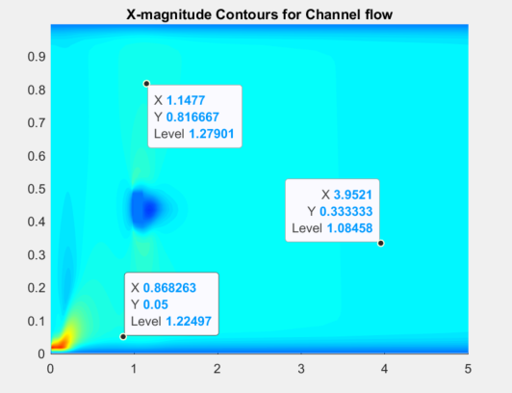
Why Use Someone Else’s Simulator?
Well… It’s kinda complicated
Computational fluid dynamics (CFD)
Based on the Navier-Stokes equation
Original Slide Design: Lorian Marshall
Notes:
Fergus talk about this one?

Slide 17

Why Use Someone Else’s Simulator?
Well… It’s kinda complicated
Computational fluid dynamics (CFD)
Based on the Navier-Stokes equation
$$∇∙u=0$$
$$ρ\frac{du}{dt}=−∇p+ μ∇^{2}u+F$$
Original Slide Design: Lorian Marshall
Notes:
Fergus talk about this one?

Slide 18
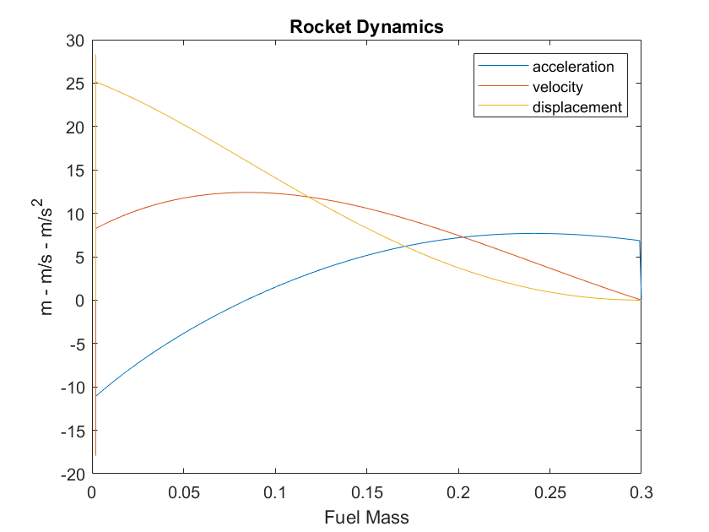

Why Use Someone Else’s Simulator?
Well… It’s kinda complicated
Computational fluid dynamics (CFD)
Based on the Navier-Stokes equation
$$∇∙u=0$$
$$ρ\frac{du}{dt}=−∇p+ μ∇^{2}u+F$$
Uses the Rocket Equation
$$∆v=I_{sp}g_{0}\ln\left(\frac{m_{f}+m_{b}}{m_{b}}\right)$$
Original Slide Design: Lorian Marshall
Notes:
Fergus talk about this one?

Slide 19
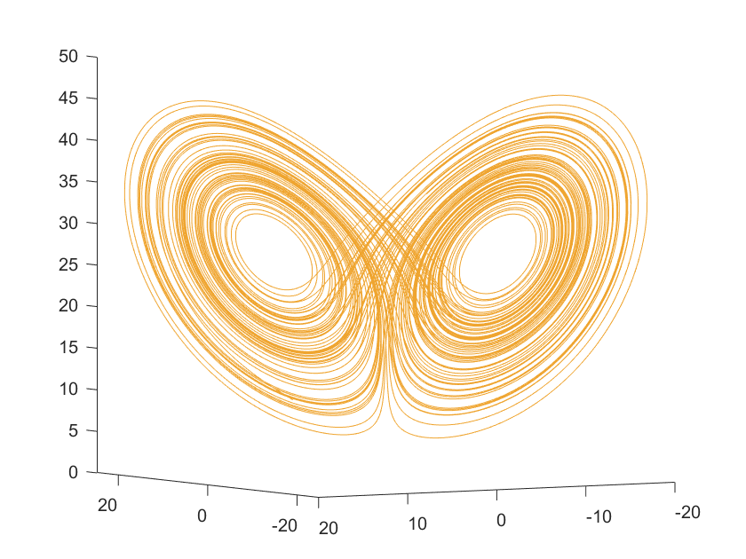
Why Use Someone Else’s Simulator?
Well… It’s kinda complicated
Computational fluid dynamics (CFD)
Based on the Navier-Stokes equation
$$∇∙u=0$$
$$ρ\frac{du}{dt}=−∇p+ μ∇^{2}u+F$$
Uses the Rocket Equation
$$∆v=I_{sp}g_{0}\ln\left(\frac{m_{f}+m_{b}}{m_{b}}\right)$$
Chaos dynamics
Original Slide Design: Lorian Marshall
Notes:
Fergus talk about this one?

Slide 20
Why Use Someone Else’s Simulator?
Well… It’s kinda complicated
Computational fluid dynamics (CFD)
Based on the Navier-Stokes equation
$$∇∙u=0$$
$$ρ\frac{du}{dt}=−∇p+ μ∇^{2}u+F$$
Uses the Rocket Equation
$$∆v=I_{sp}g_{0}\ln\left(\frac{m_{f}+m_{b}}{m_{b}}\right)$$
Chaos dynamics
Initial states are hard to measure
Original Slide Design: Lorian Marshall
Notes:
Fergus talk about this one?

Slide 21
Why Use Someone Else’s Simulator?
Well… It’s kinda complicated
Computational fluid dynamics (CFD)
Based on the Navier-Stokes equation
$$∇∙u=0$$
$$ρ\frac{du}{dt}=−∇p+ μ∇^{2}u+F$$
Just trust me… it’s difficult
Uses the Rocket Equation
$$∆v=I_{sp}g_{0}\ln\left(\frac{m_{f}+m_{b}}{m_{b}}\right)$$
Chaos dynamics
Initial states are hard to measure
Original Slide Design: Lorian Marshall
Notes:
Fergus talk about this one?

Slide 22
Alright - Let’s Make A rocket
Original Slide Design: Lorian Marshall
Notes:
Fergus talk about this one?

Slide 23
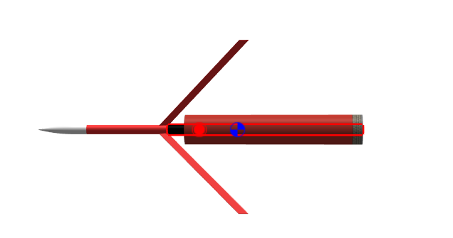
Play Around With It
Can you crash it?
Can you get the rocket into space? (100 km)
How far away can you get it?
Where’s the best launch site?
Original Slide Design: Lorian Marshall
Notes:
Fergus talk about this one?

Slide 24
Let’s Make YOUR rocket
Original Slide Design: Lorian Marshall
Notes:
Fergus talk about this one?

Slide 25
Let’s Make YOUR rocket
Nose Cone (Nose Cone)
- Shape:
- Length:
- Diameter:
- Wall Thickness:
- Material:
Payload Section (Body Tube)
- Length:
- Diameter:
- Wall Thickness:
- Material:
Body (Body Tube)
- Length:
- Diameter:
- Wall Thickness:
- Material:
Fins (Freeform)
- Shape:
- Thickness:
- Material:
Engine Mount (Engine Block)
- Model:
Parachute (Parachute)
- Model:
Payload (Mass)
- Mass:
Camera (???)
- Diameter:
- Length:
- Mass:
Motor
- Model:
Original Slide Design: Lorian Marshall

Slide 26
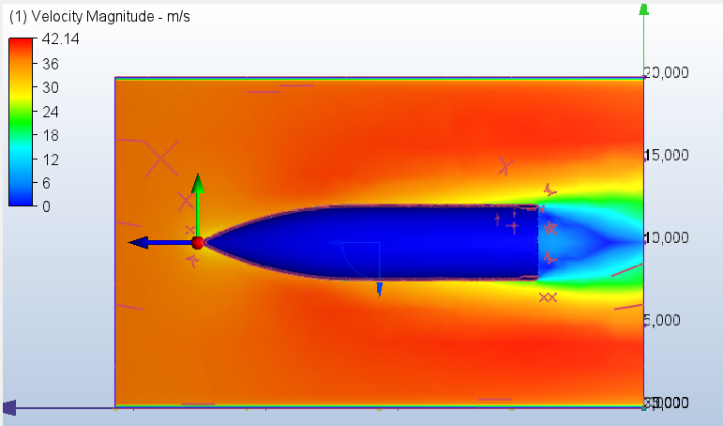
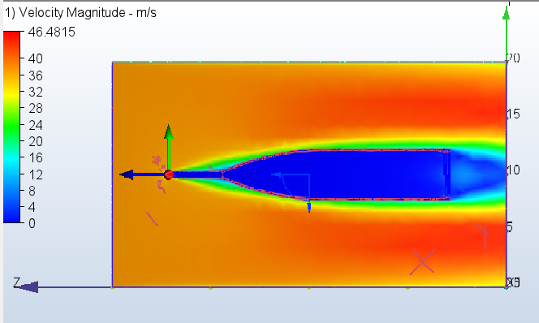
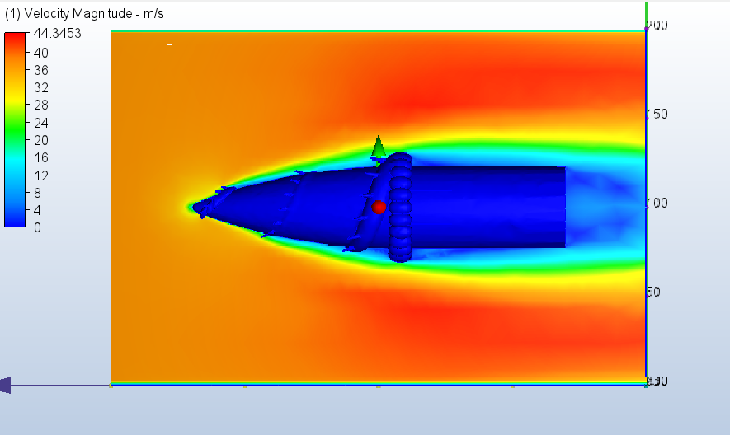



Let’s Make YOUR rocket
$$C_{D}=0.41$$
$$C_{D}=0.37$$
$$C_{D}=0.36$$
Original Slide Design: Lorian Marshall

Slide 27
Let’s Make YOUR rocket
Nose Cone (Nose Cone)
- Shape: Ogive – Shape Parameter = 1
- Length: 95 mm
- Diameter: 45.8 mm
- Wall Thickness: 1.2 mm
- Material: PLA (polylactic acid)
Payload Section (Body Tube)
- Length:
- Diameter:
- Wall Thickness:
- Material:
Body (Body Tube)
- Length:
- Diameter:
- Wall Thickness:
- Material:
Fins (Freeform)
- Shape:
- Thickness:
- Material:
Engine Mount (Engine Block)
- Model:
Parachute (Parachute)
- Model:
Payload (Mass)
- Mass:
Camera (???)
- Diameter:
- Length:
- Mass:
Motor
- Model:
- Ejection Charge Delay:
Original Slide Design: Lorian Marshall

Slide 28
Let’s Make YOUR rocket
Nose Cone (Nose Cone)
- Shape: Ogive – Shape Parameter = 1
- Length: 95 mm
- Diameter: 45.8 mm
- Wall Thickness: 1.2 mm
- Material: PLA (polylactic acid)
Payload Section (Body Tube)
- Length: 110 mm
- Diameter: 45.8 mm
- Wall Thickness: 1.2 mm
- Material: PLA
Body (Body Tube)
- Length:
- Diameter:
- Wall Thickness:
- Material:
Fins (Freeform)
- Shape:
- Thickness:
- Material:
Engine Mount (Engine Block)
- Model:
Parachute (Parachute)
- Model:
Payload (Mass)
- Mass:
Camera (???)
- Diameter:
- Length:
- Mass:
Motor
- Model:
- Ejection Charge Delay:
Original Slide Design: Lorian Marshall

Slide 29
Let’s Make YOUR rocket
Nose Cone (Nose Cone)
- Shape: Ogive – Shape Parameter = 1
- Length: 95 mm
- Diameter: 45.8 mm
- Wall Thickness: 1.2 mm
- Material: PLA (polylactic acid)
Payload Section (Body Tube)
- Length: 110 mm
- Diameter: 45.8 mm
- Wall Thickness: 1.2 mm
- Material: PLA
Body (Body Tube)
- Length: 305 mm
- Diameter: 45.8 mm
- Wall Thickness: 1 mm
- Material: Spiral/Glassine
Fins (Freeform)
- Shape:
- Thickness:
- Material:
Engine Mount (Engine Block)
- Model:
Parachute (Parachute)
- Model:
Payload (Mass)
- Mass:
Camera (???)
- Diameter:
- Length:
- Mass:
Motor
- Model:
- Ejection Charge Delay:
Original Slide Design: Lorian Marshall

Slide 30
Let’s Make YOUR rocket
Nose Cone (Nose Cone)
- Shape: Ogive – Shape Parameter = 1
- Length: 95 mm
- Diameter: 45.8 mm
- Wall Thickness: 1.2 mm
- Material: PLA (polylactic acid)
Payload Section (Body Tube)
- Length: 110 mm
- Diameter: 45.8 mm
- Wall Thickness: 1.2 mm
- Material: PLA
Body (Body Tube)
- Length: 305 mm
- Diameter: 45.8 mm
- Wall Thickness: 1 mm
- Material: Spiral/Glassine
Fins (Freeform)
- Shape: *See Board*
- Thickness: 2.38 mm
- Material: Balsa
Engine Mount (Engine Block)
- Model:
Parachute (Parachute)
- Model:
Payload (Mass)
- Mass:
Camera (???)
- Diameter:
- Length:
- Mass:
Motor
- Model:
- Ejection Charge Delay:
Original Slide Design: Lorian Marshall

Slide 31
Let’s Make YOUR rocket
Nose Cone (Nose Cone)
- Shape: Ogive – Shape Parameter = 1
- Length: 95 mm
- Diameter: 45.8 mm
- Wall Thickness: 1.2 mm
- Material: PLA (polylactic acid)
Payload Section (Body Tube)
- Length: 110 mm
- Diameter: 45.8 mm
- Wall Thickness: 1.2 mm
- Material: PLA
Body (Body Tube)
- Length: 305 mm
- Diameter: 45.8 mm
- Wall Thickness: 1 mm
- Material: Spiral/Glassine
Fins (Freeform)
- Shape: *See Board*
- Thickness: 2.38 mm
- Material: Balsa
Engine Mount (Engine Block)
- Model: EB-50
Parachute (Parachute)
- Model:
Payload (Mass)
- Mass:
Camera (???)
- Diameter:
- Length:
- Mass:
Motor
- Model:
- Ejection Charge Delay:
Original Slide Design: Lorian Marshall

Slide 32
Let’s Make YOUR rocket
Nose Cone (Nose Cone)
- Shape: Ogive – Shape Parameter = 1
- Length: 95 mm
- Diameter: 45.8 mm
- Wall Thickness: 1.2 mm
- Material: PLA (polylactic acid)
Payload Section (Body Tube)
- Length: 110 mm
- Diameter: 45.8 mm
- Wall Thickness: 1.2 mm
- Material: PLA
Body (Body Tube)
- Length: 305 mm
- Diameter: 45.8 mm
- Wall Thickness: 1 mm
- Material: Spiral/Glassine
Fins (Freeform)
- Shape: *See Board*
- Thickness: 2.38 mm
- Material: Balsa
Engine Mount (Engine Block)
- Model: EB-50
Parachute (Parachute)
- Model: PK-18A, 85566
Payload (Mass)
- Mass:
Camera (???)
- Diameter:
- Length:
- Mass:
Motor
- Model:
- Ejection Charge Delay:
Original Slide Design: Lorian Marshall

Slide 33
Let’s Make YOUR rocket
Nose Cone (Nose Cone)
- Shape: Ogive – Shape Parameter = 1
- Length: 95 mm
- Diameter: 45.8 mm
- Wall Thickness: 1.2 mm
- Material: PLA (polylactic acid)
Payload Section (Body Tube)
- Length: 110 mm
- Diameter: 45.8 mm
- Wall Thickness: 1.2 mm
- Material: PLA
Body (Body Tube)
- Length: 305 mm
- Diameter: 45.8 mm
- Wall Thickness: 1 mm
- Material: Spiral/Glassine
Fins (Freeform)
- Shape: *See Board*
- Thickness: 2.38 mm
- Material: Balsa
Engine Mount (Engine Block)
- Model: EB-50
Parachute (Parachute)
- Model: PK-18A, 85566
Payload (Mass)
- Mass: 61 g
Camera (???)
- Diameter:
- Length:
- Mass:
Motor
- Model:
- Ejection Charge Delay:
Original Slide Design: Lorian Marshall

Slide 34
Let’s Make YOUR rocket
Nose Cone (Nose Cone)
- Shape: Ogive – Shape Parameter = 1
- Length: 95 mm
- Diameter: 45.8 mm
- Wall Thickness: 1.2 mm
- Material: PLA (polylactic acid)
Payload Section (Body Tube)
- Length: 110 mm
- Diameter: 45.8 mm
- Wall Thickness: 1.2 mm
- Material: PLA
Body (Body Tube)
- Length: 305 mm
- Diameter: 45.8 mm
- Wall Thickness: 1 mm
- Material: Spiral/Glassine
Fins (Freeform)
- Shape: *See Board*
- Thickness: 2.38 mm
- Material: Balsa
Engine Mount (Engine Block)
- Model: EB-50
Parachute (Parachute)
- Model: PK-18A, 85566
Payload (Mass)
- Mass: 61 g
Camera (Pod + Body Tube)
- Diameter: 11 mm
- Length: 58.4 mm
- Mass: 23 g
Motor
- Model:
- Ejection Charge Delay:
Original Slide Design: Lorian Marshall

Slide 35
Let’s Make YOUR rocket
Nose Cone (Nose Cone)
- Shape: Ogive – Shape Parameter = 1
- Length: 95 mm
- Diameter: 45.8 mm
- Wall Thickness: 1.2 mm
- Material: PLA (polylactic acid)
Payload Section (Body Tube)
- Length: 110 mm
- Diameter: 45.8 mm
- Wall Thickness: 1.2 mm
- Material: PLA
Body (Body Tube)
- Length: 305 mm
- Diameter: 45.8 mm
- Wall Thickness: 1 mm
- Material: Spiral/Glassine
Fins (Freeform)
- Shape: *See Board*
- Thickness: 2.38 mm
- Material: Balsa
Engine Mount (Engine Block)
- Model: EB-50
Parachute (Parachute)
- Model: PK-18A, 85566
Payload (Mass)
- Mass: 61 g
Camera (Pod + Body Tube)
- Diameter: 11 mm
- Length: 58.4 mm
- Mass: 23 g
Motor
- Model: C11
- Ejection Charge Delay: 3 s
Original Slide Design: Lorian Marshall

Slide 36
Simulation Time
Original Slide Design: Lorian Marshall
Notes:
Fergus talk about this one?

Slide 37
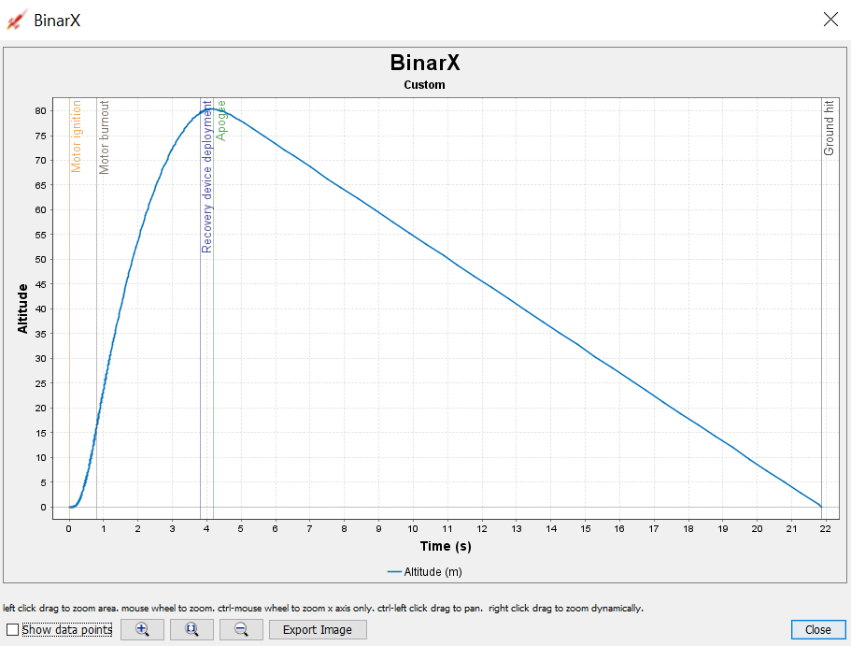
Results
Did it crash?
How high did it go?
- Is this allowed?
How fast did it go?
How long will it be in the air?
How fast will it hit the ground?
How far away will it land?
Are any changes needed?
Original Slide Design: Lorian Marshall
Notes:
Fergus talk about this one?

Slide 38
Go For Launch?
Original Slide Design: Lorian Marshall
Notes:
Fergus talk about this one?

